Slide 1


EXCEPTION HANDLING

Slide 2

CONTENTS
What is Exception?
Why should we catch exceptions ?
'Exception' and 'Error' ?
The different kinds of exceptions
Namespace
Some System/Runtime Exceptions
What is Exception Handling?
Structured Exception Handling

Slide 3
CONTENTS
try/catch Blocks
Multiple Catch Blocks
Finally Blocks
Application Exception
Defensive Programming
Best Practices for Handling Exceptions

Slide 4

What Is Exception???
Exception is an event during the execution of the program
It disrupts the normal flow of instructions during the execution of a program.
It disrupts the normal flow of instructions during the execution of a program.
It disrupts the normal flow of instructions during the execution of a program.
An exception is an unexpected state during the execution of code.

Slide 5

Why should we catch exceptions
To make your program robust and reliable.
And it is vital for ensuring the quality of your code .
A good programmer is someone who never introduce bad code in his projects
If an exception is not 'handled' in code
The application will crash and user will see an ugly message.
Instead, you can catch the exception, log the errors and show a friendly message to the user.

Slide 6
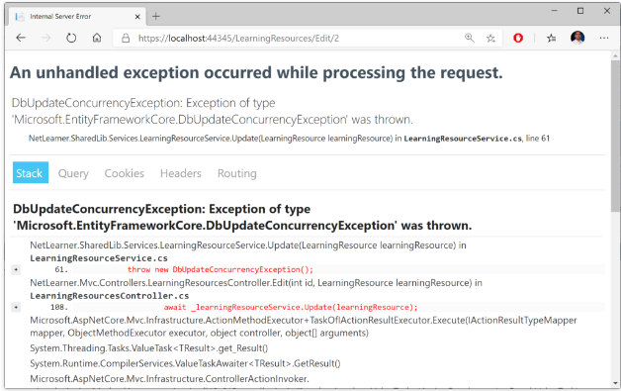
Example:

Slide 7

' Exception and Error?
An error is the event; an exception is the object that event creates.
When an error interrupts the flow, the program tries to find an exception handler
A block of code that tells it how to react,Which will help it resume the flow.

Slide 8
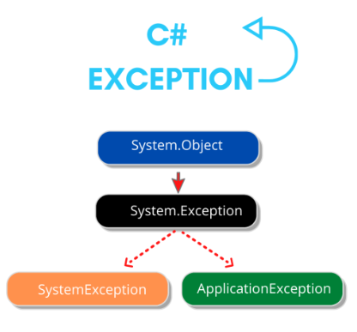
TYPES OF EXCEPTION
SYSTEM EXCEPTION
Thrown by the CLR at run time
APPLICATION EXCEPTION
Thrown By Application,using “throw” Clause

Slide 9
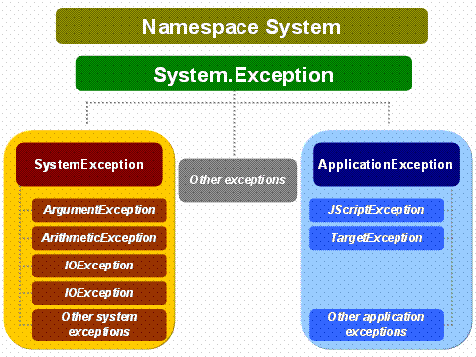
Namespace
System.Exception is the base class for all exceptions in C#.

Slide 10

System/Runtime Exceptions
OutOfMemoryException
IndexOutOfRangeException
OutOfMemoryException
IndexOutOfRangeException
OutOfMemoryException
IndexOutOfRangeException
OutOfMemoryException
IndexOutOfRangeException
NullReferenceException
Arithmetic Exception
Arithmetic Exception
Arithmetic Exception
Arithmetic Exception
InvalidCastException
OverFlowException
OverFlowException
OverFlowException
ArrayTypeMismatchException
ArrayTypeMismatchException
DivideByZeroException

Slide 11

What Is Exception Handling??
“Exception handling" means interpreting and reacting to the exceptions created by errors.
Built mechanism in .NET framework to detect and handle run time errors.
Achieved using the Try - Catch - Finally block

Slide 12

Structure:
Code Bolock for which we want to catch some Exception
try{
........ }
catch(SomeException e1){
.....
}
catch(AnotherException e2){ .....
}
finally{
.....
}
Each catch deals with class of Exceptions,determined by the run-time system based on the type of the argument
The code in finally is executed always after leaving the try-block

Slide 13
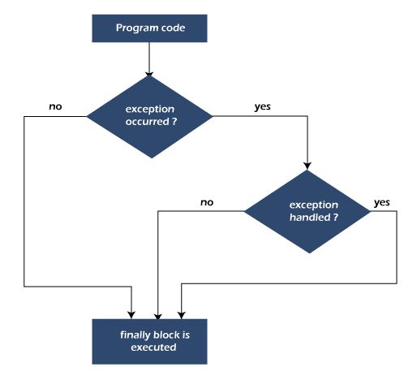
Work Flow:
Structured exception handling tests specific pieces of the code when exception occurs.
The Try...Catch...Finally control structure is fundamental to structured exception handling.
It Reacts differently based on the type of thrown exception.

Slide 14
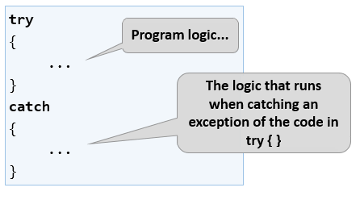
try/catch Blocks
When exceptions are thrown, It must be handled
Done by using try-catch block
This done by,
Done by using try-catch block
Code that could throw an exception is put in the try block
Exception handling code goes in the catch block
And an exception handling code goes in the catch block

Slide 15

Multiple Catch Blocks
A try block can throw multiple exceptions, which can handle by using multiple catch blocks.

Slide 16

Structure:
Class program{
private void DoSomething(){
try
{
throw new ArgumentNullException();
}
catch(ArgumentNullException ex)
{
//will reach here..
}
catch(ArgumentException ex)
{
will reach here...
}
} }

Slide 17
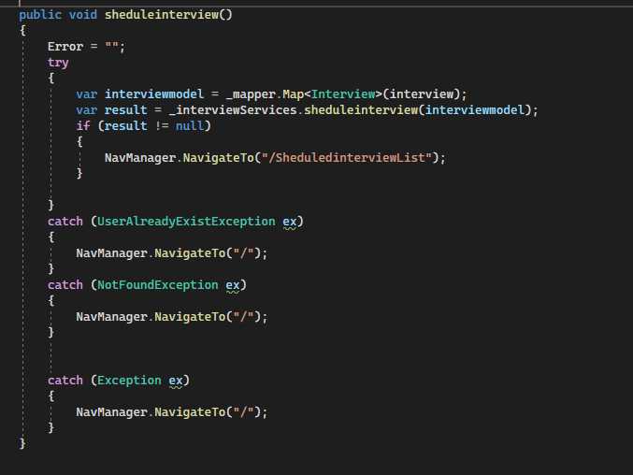
Example:

Slide 18

Finally Blocks
Finally block must appear after all the catch block.
Contains the code that always executes, whether or not any exceptin ocurs.
If you use transfer control statement in finally block, you will receive compile time error.

Slide 19

When to use finally block ?
A code fragment that must be executed regardless of exception.
Cleaning up resources such as closing file objects, releasing database connections etc.
Only One finally block is associated with try block.

Slide 20
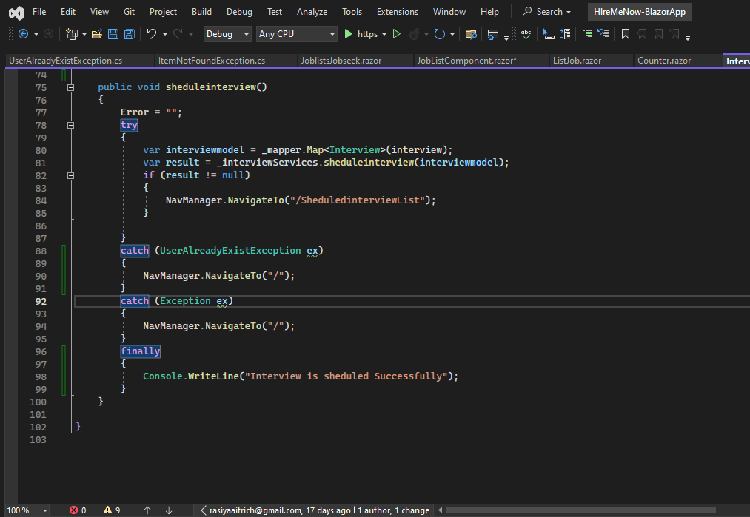
Example:

Slide 21

Application Exception
Thrown by a user program, not by the common language runtime
Create a custom exception class by deriving the ApplicationException class.
The throw statement is used to signal the occurrence of an anomalous situation (exception) during the program execution.

Slide 22

Diffensive Programming
Defensive programming is a technique that makes programs more robust to unexpected events .
Less program "crashes" at run time ,It increases the quality of software.
Defensive Programming is the concept of avoiding the exceptional situations to occur, even before it can occur, and exception handling is about handling an exception after it has happened,

Slide 23
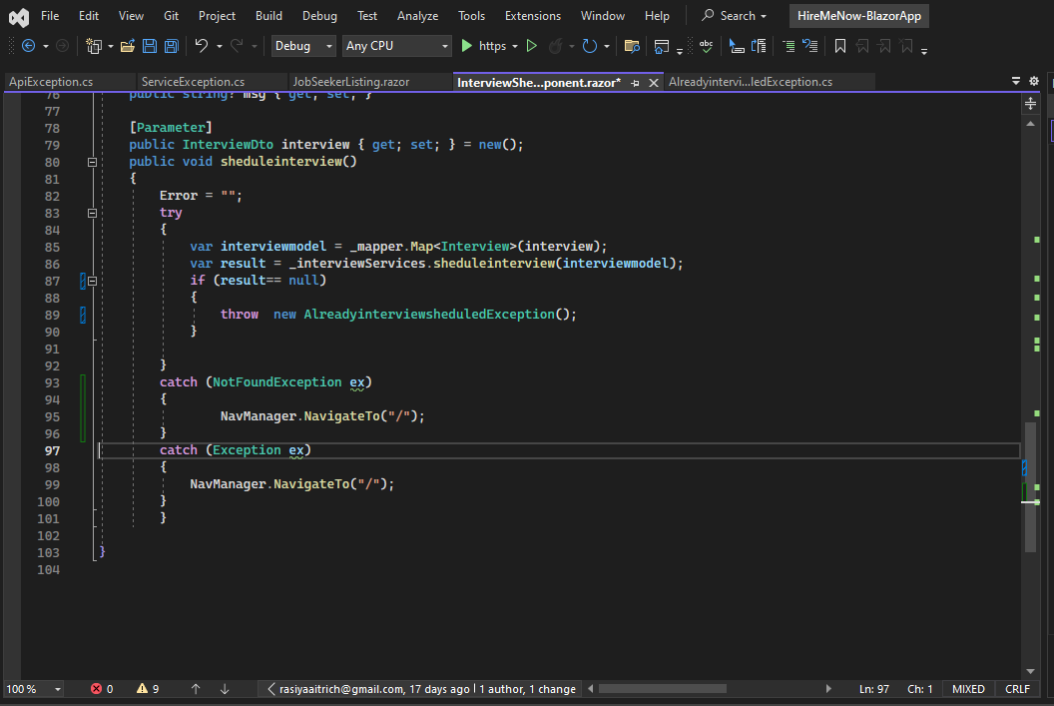
Example:

Slide 24

Defensive Programming Strategies
Check For Nulls
Be Careful When Working with Arrays
Use Safe Parsing
Check Object State
Check Your Arguments
Use Safe Parsing

Slide 25

Best Practices for Handling Exceptions
A well-designed set of error handling code blocks can make a program more robust and less prone to crashing the application
Know when to use a try/catch block
Use try/finally blocks around code that can potentially generate an exception and centralize your catch statements in one location.

Slide 26
End exception class names with the word "Exception".
In C# and the Managed Extensions for C++, use at least the three common constructors when creating your own exception classes.
Use grammatically correct error messages, including ending punctuation

Slide 27


